Slide 1

Demonstration of SDK (Software Development
Kit)
Notes:
“Now, let’s take a closer look at the tool itself. “

Slide 2
A Quick Preview: Key Functions and Benefits of SDK
Features of caCORE SDK
  Generates a data service from UML model
  Supports ArgoUML and Enterprise Architect
  Integrated security with CSM
  Supports connection to multiple services
Benefits of caCORE SDK
  Consistent UML representation of the data
  Rapid data service generation
  Uniform way to access data
  Query using information model
  Seamless integration with cagrid tools
caCORE SDK Users
Clinical Trials
  C3PR
  CTOM
  Cactus
Genomics
  caArray
  caIntegrator
  caBio
  Rembrandt
Proteomics
  PIR
Imaging
  NCIA
Tissue Banking
  caTissue
Infrastructure
  EVS
  caDSR
  UML Project
Notes:
Speaker: On this slide, quickly preview the workflow elements that you are going to present, focusing on why a user would be interested – e.g., the scientific problem or need it addresses. Make sure that the demo that follows clearly maps to this preview, so that people can see the link between the demonstration and the workflow element it addresses.

Slide 3
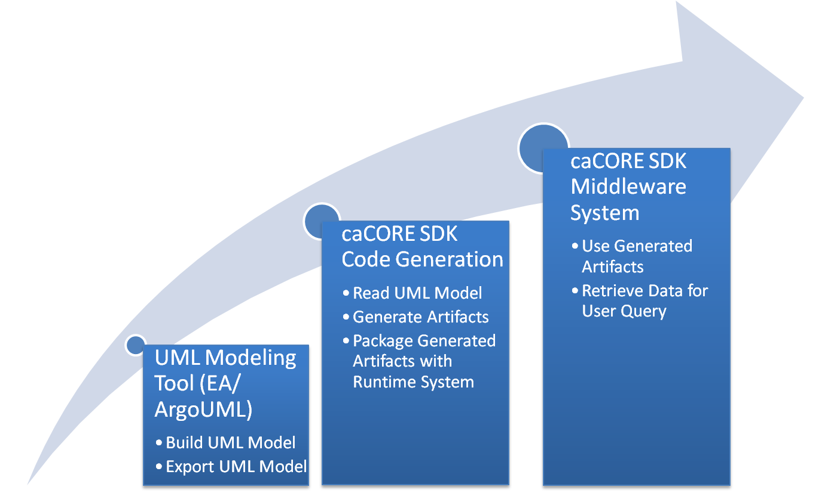
caCORE SDK Workflow
Notes:
(Begin demonstration with a “lay of the desktop” – when users first see the screen, what sections should they focus on for what?) “The key functions of the tool are captured in menus along the top/left/bottom of the screen. The submenu on the ___ helps you do this, the menu on the __ helps you do that. The center of the screen is where you will do ___.” (This/that could include data entry, data management, reporting, analysis, etc).
(Then, walk through 3-4 use cases that show the workflow and functionality that are most critical to know.) “One of the most common functions used by ___ users is to ___ in order to ___.” OR “Here’s a feature generally used by (end user group) to (describe functionality in the context of the business process). Let’s take a look at how you would do that.” (Close use case by reconnecting the function to a common challenge) – sample: “Adopters of this tool have found that this function really saves (time/money/error/fill in) because it addresses (this common problem/challenge.)
(Use the shapes, text boxes, and arrows in the following template slide to illustrate the tool features you are discussing. During the recorded demo, you can “screen cast” the tool interface – however, these pre-prepared labeled screen shots should be generated regardless – both as a preparation step, and as a back-up.)

Slide 4
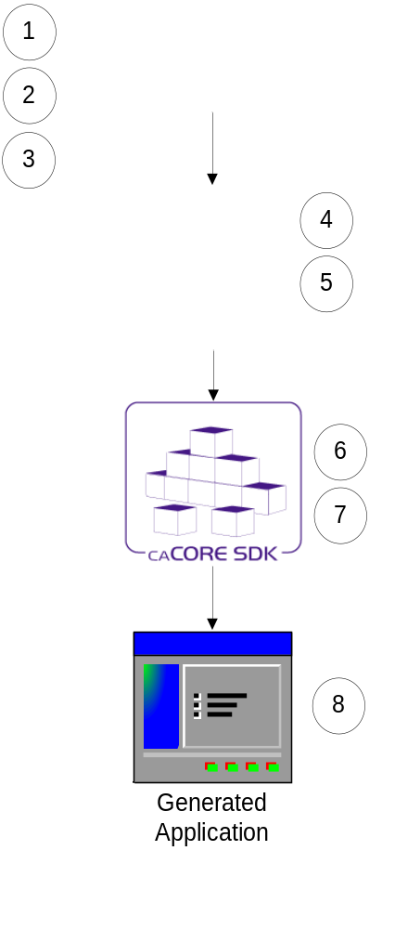
Running the Code Generator
Create Object Model (EA/ArgoUML)
Create Data Model (EA/ArgoUML)
Export the model in XMI format
Perform Object to Table mapping (caAdapter)
Perform Attribute to Column mapping (caAdapter)
Configure the code generator
Run the code generator
Running the generated system
Assumption: Database is already configured and tables are populated with data
Note: Steps 4 & 5 can be performed in EA/ArgoUML without using caAdapter.

Slide 5











SDK Generated System’s Architecture
Core Services
Registered in
Registered in
Semantically described with terminology from
Object
Definition
WSDL
XSD
Map to
Service Definition
Validate against
SDK Service
Generated by Introduce
SDK Service API
SDK Client API
Grid Service
Grid Client API
Client App
Oracle
Database
Objects
Java API
Reads
XML
Objects
MySQL
Database
Objects
Java API
Reads
Objects
Client uses
Service Definition
WSDL
XSD
Validate against
Web Service
Client uses
CSM
Security
Database
XML
Checks
Internet Browser
HTTP/REST
XML/ HTML

Slide 6
The Next Step: Accessing Online Resources for SDK
caCORE SDK | http://ncicb.nci.nih.gov/NCICB/infrastructure/cacoresdk
Tool Landing Page | Insert URL ??? Probably N/A
Access to Demo Passwords and Logins | N/A
Software Development Project Site | https://gforge.nci.nih.gov/projects/cacoresdk/
(Insert LISTSERV Name) LISTSERV Signup | cacoresdk_users-l@list.nih.gov
Programmer’s Guide | https://gforge.nci.nih.gov/docman/view.php/148/8650/caCORE%20SDK%204.0%20Developer's%20Guide_101007.pdf
NCI Center for Bioinformatics Applications Support | ncicb@pop.nci.noh.gov
Notes:
“Here are some critical URL’s and e-mail addresses to get you started – the Tool Landing page is where the most recent release and documentation and training for the tool is kept, so it’s a great starting place.”

